Slide 1
Sarcomas
Paul George Fellow Teaching

Slide 2
Rhabdomyosarcoma, Osteosarcoma, Ewing Sarcoma
Sarcoma – malignant tumor of mesenchymal cell origin
Notes:
Mesenchymal = derived from the mesoderm; type of connective tissue
Mesenchymal cells normally mature into skeletal muscle, fat, fibrous tissue, bone, cartilage

Slide 3
Rhabdomyosarcoma
Majority thought to arise from mesenchymal tissue committed to skeletal muscle lineage, but can also occur elsewhere (e.g. bladder)
Approximately 3% of childhood/adolescent cancer
Histologic subtype includes:
Embryonal
Alveolar
Other (pleomorphic/anaplastic, mixed, spindle cell)
Notes:
(~400 cases/year in US)

Slide 4
Rhabdomyosarcoma
Can be associated with genetic, cancer predisposition syndromes
Neurofibromatosis, Li Fraumeni, Beckwith-Wiedemann, Costello syndrome
Parental marijuana and cocaine use also associated with 3-5 fold increase in risk
Notes:
Li and Fraumeni first identified the syndrome using children with RMS
Costello syndrome is an extremely rare disorder that affects multiple organ systems of the body. This condition is characterized by growth delays after birth; short stature; extra loose skin on the neck, palms of the hands, fingers, and soles of the feet; noncancerous tumors (papillomata) around the face and anus; developmental delay and intellectual disability; and a characteristic facial appearance.

Slide 5
Rhabdomyosarcoma (RMS) – Molecular biology
PAX-FOX01 fusions are characteristic of alveolar RMS
20% of alveolar RMS are fusion negative
PAX-FOX01 fusion negative is characteristic of embryonal RMS
Known to have LOH at 11p15 locus
Dysregulated developmental pathways play a role in RMS tumorigenesis
Sonic hedgehog, Wnt, Notch, Hippo
Notes:
PAX3/7-FOX01 fusions results in abnormal gene activation, and results in lower burden of mutations than PAX3/7-FOX01 fusion negative tumors
PAX3 is on chromosome 2, FOX01 is on chromosome 13, more common mutation by about 3/1
PAX7 is on chromosome 1, FOX01 is on chromosome 13, less common mutation
RMS is not yet subcategorized by which developmental pathway is dysregulated, but ongoing active investigation and drug development

Slide 6
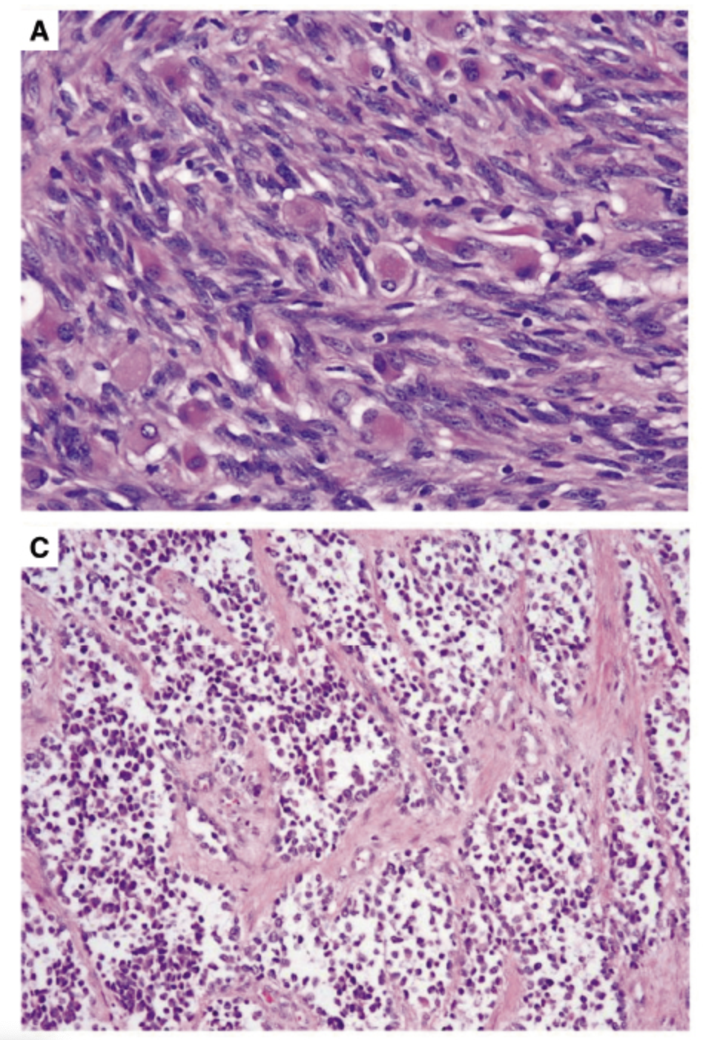
RMS - Pathology
RMS represents one of the small round blue cell tumors of childhood
Immunohistochemical staining: muscle-specific actin and myosin, desmin, myoglobin, Z-band protein, and MyoD
Evidence of skeletal muscle gene expression is not sufficient to make a diagnosis of RMS
International Classification Scheme
ERMS
Botryoid and spindle cell are ERMS variants a/w superior prognosis
ARMS
>50% of tumor must show alveolar pattern
Notes:
It is important to emphasize that evidence of skeletal muscle gene expression is not sufficient to make a diagnosis of RMS, as Wilms, pleuropulmonary blastoma, de-differentiated chondrosarcoma, liposarcoma can have muscle elements
Embryonal RMS (ERMS) (panel A): Typical spindle-shaped cells with stromal-rich appearance and scattered large rhabdomyoblasts
Alveolar RMS (ARMS) (panel C): Typical small round cells with dense appearance, lined up along spaces resembling pulmonary alveoli.

Slide 7
RMS – Clinical presentation
Peak ages in infancy and 10-15 years
Can arise anywhere in the body
Head and neck are most common in children < 8 years and, if arising in orbit, almost exclusively embryonal
Extremity tumors are more commonly seen in adolescents and are more frequently alveolar
Botryoid variant (arising from bladder or vagina) is seen almost exclusively in younger children
Appox 20% of newly diagnosed patients have distant mets
alveolar histology with local invasion (T2) is associated with an increased risk of distant metastases
Notes:
Can present with mass, cranial nerve palsy, hematuria
PM sites (often referred to as skull base and including the nasal cavity and paranasal sinuses, pterygopalatine/infratemporal fossa, nasopharynx, and middle ear)
Other includes: pelvic, retroperitoneal, perianal, biliary track
Between 15% and 25% of newly diagnosed patients have distant metastases, and almost half of those patients have only a single site of involvement (most commonly consisting of one or more pulmonary metastases).
The lung is the most frequent site of metastasis (40% to 50%); less common sites, either isolated or in conjunction with multimetastatic disease, are the bone marrow (20% to 30%), bone (10% to 15%), and, depending on the site of the primary tumor, lymph node (up to 40%

Slide 8
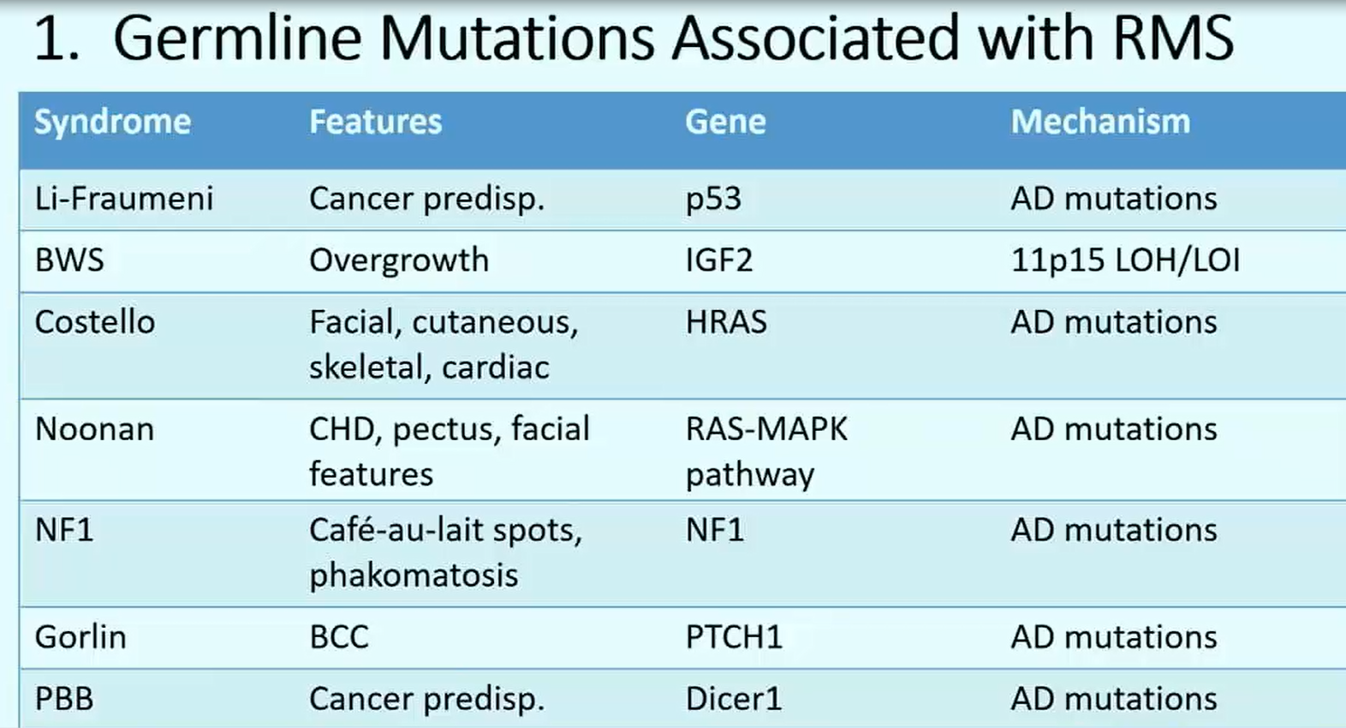
Li & Fraumeni initially described the cancer pre-disposition syndrome, which gene was later found to be p53, in children with RMS (many of whose mothers had breast cancer)

Slide 9
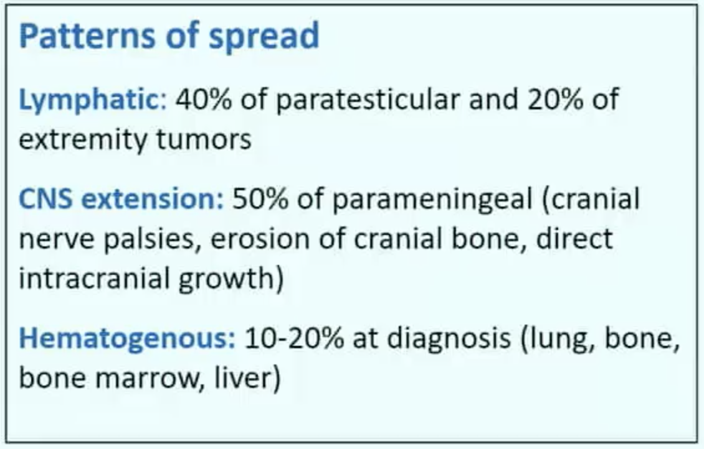
RMS – Initial workup
Typical labs
Primary MRI/CT and lung CT in all patients
Role of PET scan continues to be defined
CSF cytology for PM tumors
Bone marrow biopsy?
Of approx. 1,000 patients treated on IRS-IV, only 12 of the 901 patients with no other sites of metastatic disease were found to have isolated bone marrow metastases. Thus, in the absence of other metastatic lesions, the likelihood of finding isolated bone marrow metastases is less than 2%, and a publication from the COG suggested that bone marrow aspirates and biopsies are not needed in at least one-third of patients (i.e. ERMS, T1, NO, normal CBC, no other mets identified).
Notes:
IRS – Intergroup Rhabdomyosarcoma Studies

Slide 10
Notes:
Note that alveolar is towards the bottom, and favorable / nonfavorable site is important
Recent data clearly show that age is an independent prognostic factor, with those younger than 1 year or older than 10 years having a less favorable outcome
there are conflicting data on whether fusion subtype in ARMS is prognostically significant.

Slide 11
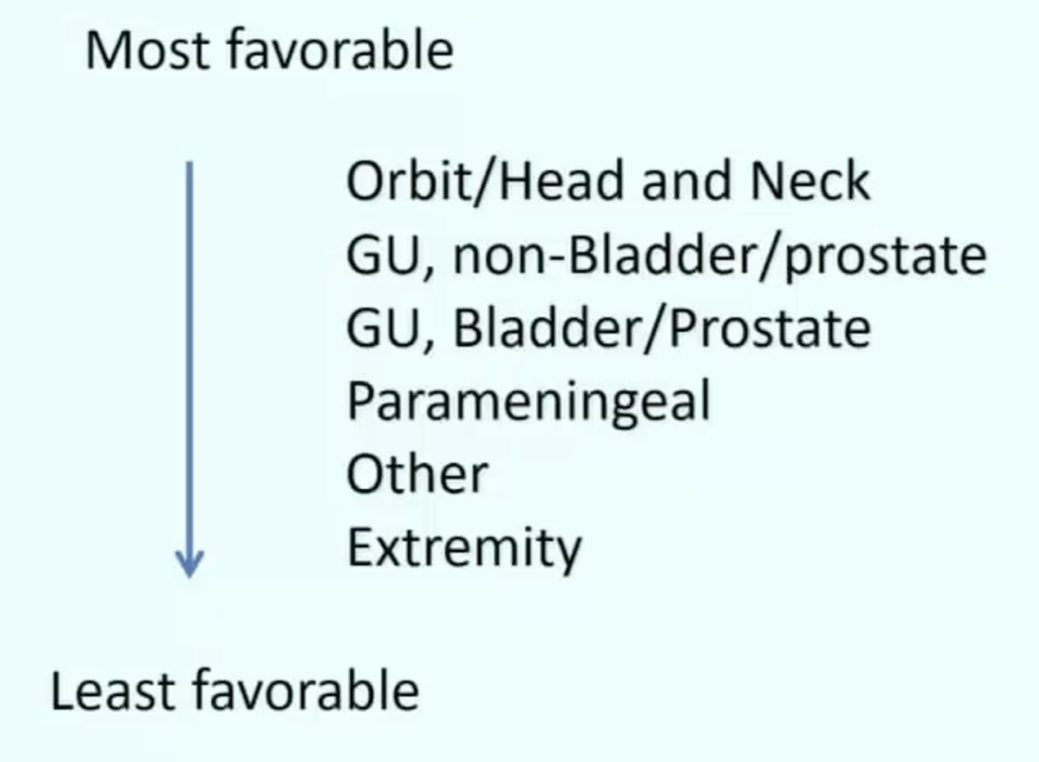
RMS - primary site
Favorable sites include the orbit and eyelid, and other non-PM head and neck structures, as well as nonbladder, nonprostate genitourinary locations (paratesticular, vulva–vagina–cervix–uterus).
All other primary sites are considered unfavorable sites and include the extremities (including the buttocks and perineum), urinary bladder and prostate, cranial PM sites, and the trunk and retroperitoneum.
Notes:
Extremity is the least favorable site

Slide 12
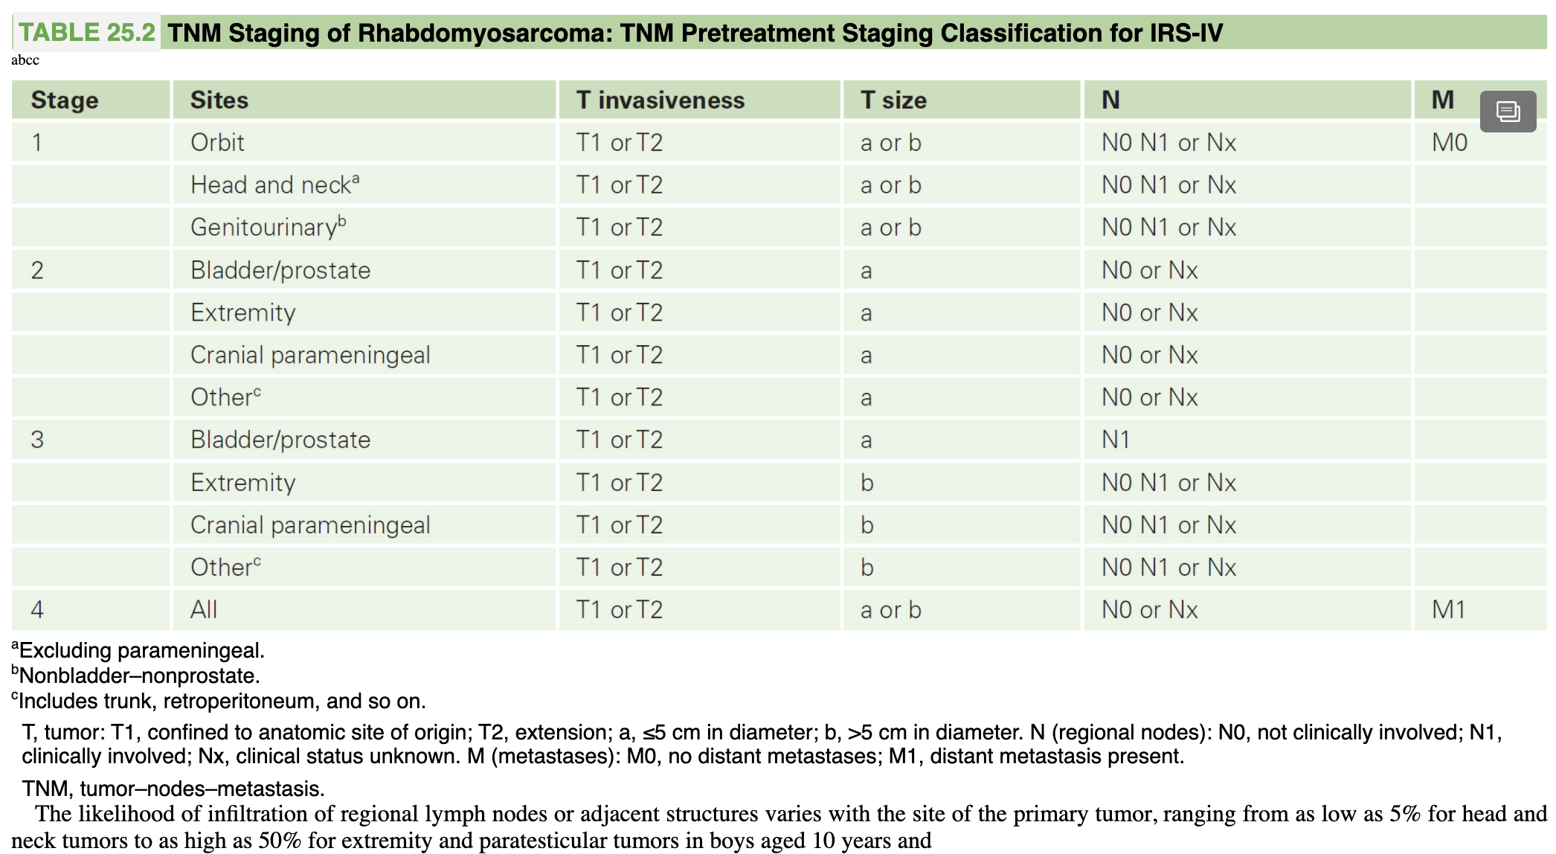
Stage –based on degree of spread, clinical and imaging

Slide 13
Notes:
Note that alveolar is towards the bottom, and favorable / nonfavorable site is important
Recent data clearly show that age is an independent prognostic factor, with those younger than 1 year or older than 10 years having a less favorable outcome
there are conflicting data on whether fusion subtype in ARMS is prognostically significant.

Slide 14
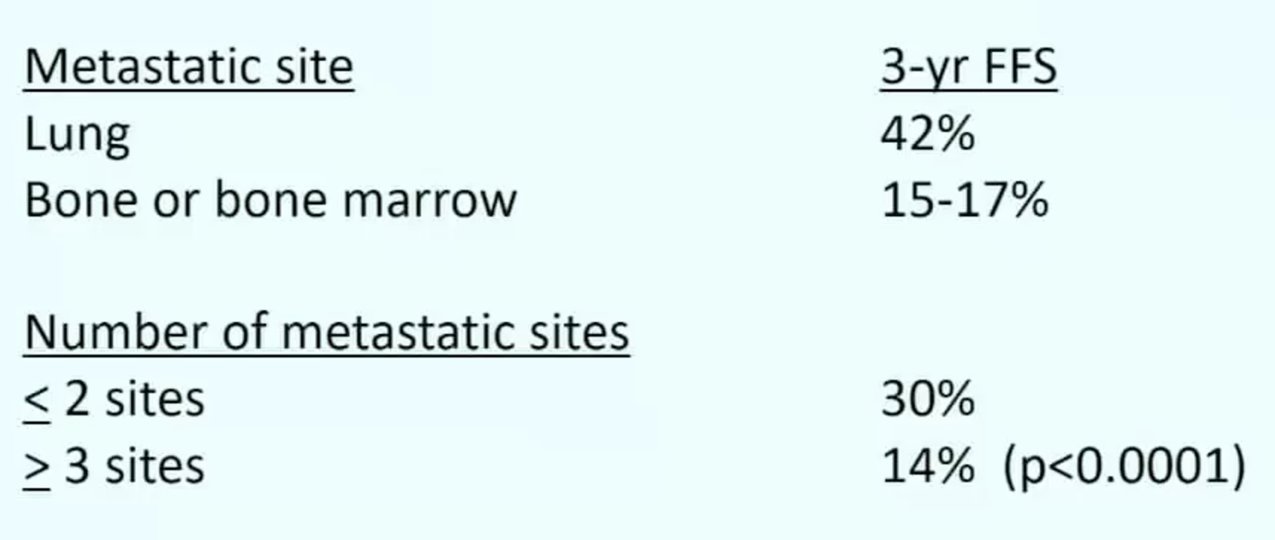
RMS - metastatic site

Slide 15
RMS - outcomes
Panel A – Localized Panel C – Stage IV
Notes:
KM curves of what we have already discussed

Slide 16
RMS - Management
The three currently recognized modalities of treating children with sarcomas are
surgical removal (if feasible)
RT for control of residual bulk or microscopic tumor
systemic chemotherapy (for primary cytoreduction and eradication of gross and micrometastases)

Slide 17
RMS – Surgery
Excision of primary tumor upfront whenever possible if subsequent function or cosmesis will not be greatly impaired
In some sites, such as the vagina and female genital tract, the urinary bladder, the orbit, and the biliary tract, aggressive surgical treatment is unwarranted
In other sites, such as the head and neck, a diagnostic incisional biopsy may be the only feasible surgical procedure because of proximity to vital blood vessels and nerves or cosmetic considerations or both
Paratesticular tumors should be removed by radical inguinal orchiectomy
Wide local excision of vulvar and vaginal tumors is rarely indicated before the commencement of primary chemotherapy. These tumors usually respond sufficiently well to induction chemotherapy to render them easily resectable
Initial complete surgical removal of extremity sarcomas should be attempted, provided that limb function will not be greatly impaired, because the prognosis is considerably worse if grossly visible tumor is left behind
Surgical removal should be attempted for truncal lesions
Notes:
Delayed primary resection is sometimes done if needed chemo to make tumor resectable
Nonetheless, given the poor outcome of such patients with conventional chemotherapy alone, removal of metastatic deposits (e.g., pulmonary nodules) may be of benefit in selected patients who have otherwise responded well to induction chemotherapy, particularly if potentially active chemotherapeutic agents or RT approaches are still available

Slide 18
RMS - Radiation therapy
XRT is a major tool in the treatment of children with RMS in the United States
Patients with group 1 ERMS do not receive XRT – all others do
A cumulative dose between 36 and 41.4 Gy is generally sufficient to control microscopic residual disease
Higher cumulative RT doses between 50.4 and 59.4 Gy (45 to 50.4 Gy for orbital tumors depending on the chemotherapy regimen and the completeness of the response to pre-RT chemotherapy) are utilized to control gross residual disease
Most patients can have treatment safely delayed until at least 12 weeks after diagnosis, after a period of neoadjuvant chemotherapy, during which tumor regression is the norm, and patients with metastatic disease typically have local RT delayed for 5 to 6 months in order to not compromise the delivery of systemic therapy
In the absence of overt meningeal involvement, whole-brain irradiation is now unwarranted for cranial PM tumors
Current COG treatment guidelines recommend that all patients with completely resected ARMS receive postoperative RT to a dose of at least 36 Gy.
Notes:
RT is a major tool in the treatment of children with RMS in the United States and the treatment modality for which the greatest philosophical differences of opinion and practice exist between the COG and other North American investigators and many European cooperative groups where RT is less uniformly applied
Group 1 = completely resected

Slide 19
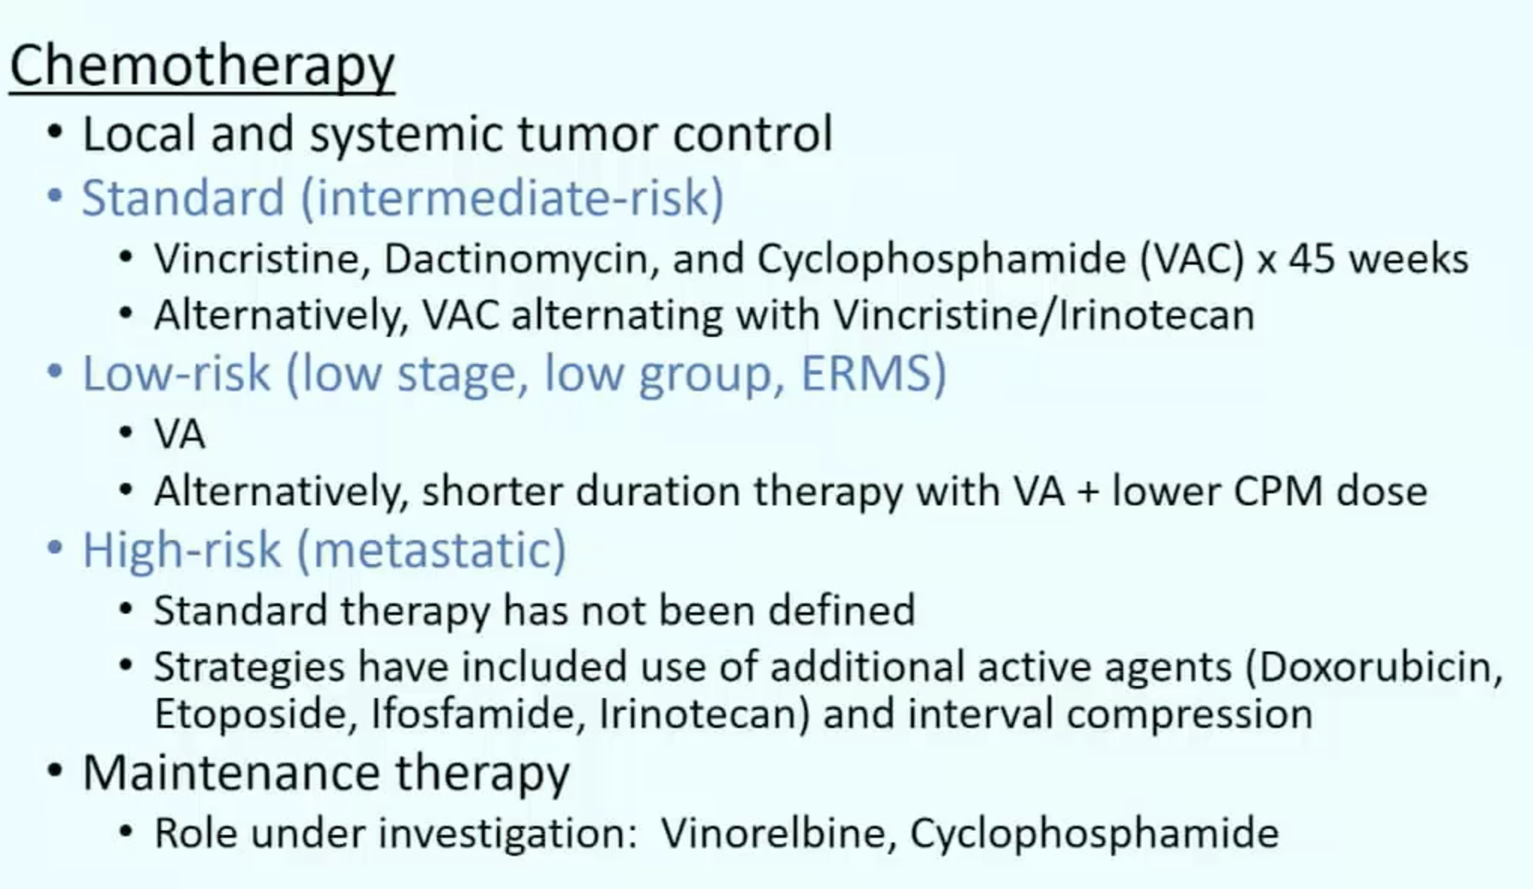
RMS – Chemotherapy
Because most relapses occur within 2 or 3 years of diagnosis, two to five chemotherapeutic agents have historically been administered for 12 to 24 months with a trend toward decreased total length of therapy in the newer studies.
Notes:
Maintenance therapy done in Europe

Slide 20
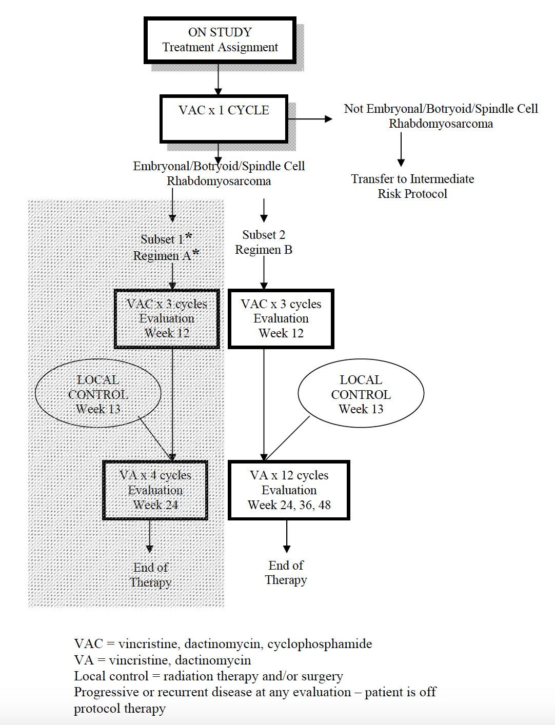
ARST0331

Slide 21
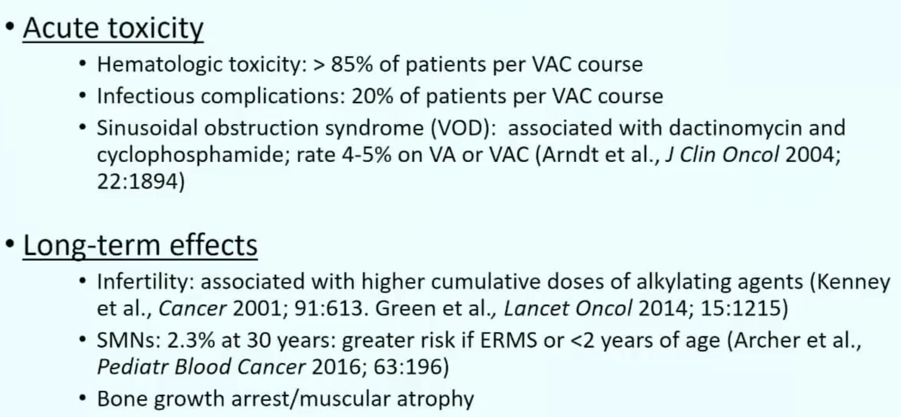
Notes:
Bone grown arrest/atrophy 2/2 XRT
SMN – subsequent malignant neoplasm
Alkylating agent = cyclophosphamide here

Slide 22
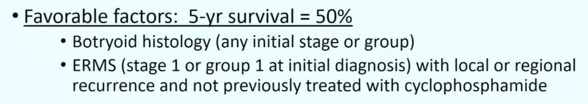
RMS – relapse
95% of all relapses occurred within 3 years of diagnosis; the latest reported recurrence was at 9 years.
The median survival time from first recurrence was 0.8 years
Fewer than 20% of patients alive 5 years from relapse.
Local recurrence accounts for 60-70% of recurrences
In contrast to localized recurrence, in which the chance of long-term survival is a small but real possibility, patients in whom recurrence develops with metastatic disease are essentially incurable.

Slide 23
Questions? Comments? Concerns?
PAX-FOX01 genetic mutation
Part of Li-Fraumeni (and other cancer predisposition syndromes)
Most common primary site is head and neck (but can occur anywhere)
Favorable sites are: orbit, non-parameningeal head and neck, nonbladder, nonprostate genitourinary locations
Least favorable site: extremity (apparently common board question)
Mets go to lung, bone, bone marrow, liver
Treatment is surgery, XRT, and chemotherapy
Only group 1 ERMS do not receive XRT
Very poor prognosis with relapse

